Slide 1

Insert baby online shop name here
MPPL - E08

Slide 2

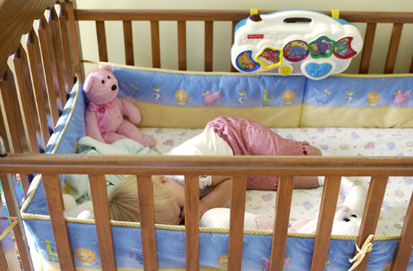

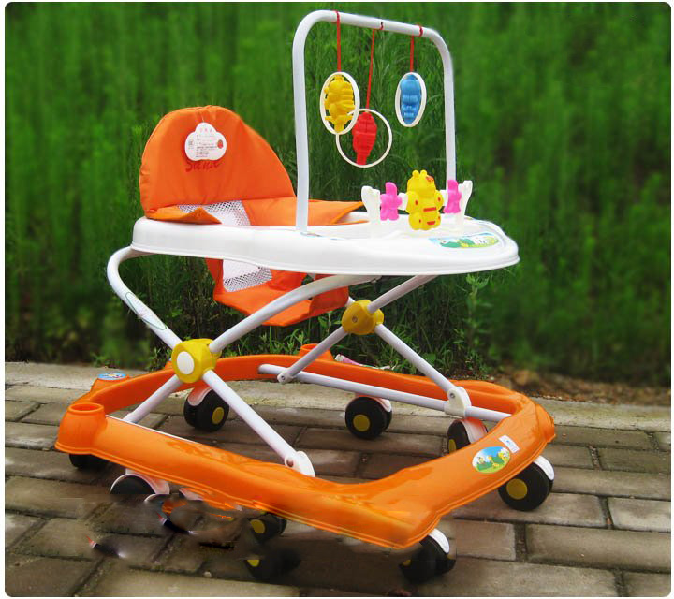
A baby online shop

Slide 3


What can we do?
Stakeholder
Customer

Slide 4
What might gone wrong?
Overloaded servers
Redundant order
Confusing bookkeeping

Slide 5
What are the problems?
Database (up to date, easy to access, non-redundant)
The two approach
Online server (less cost, server problem might be an issue)
Physical server (more cost, more robust)

Slide 6
Cost projection
online
physical

Slide 7



Thank You

Slide 8
Kelompok MPPL E08
5109100182 Ardhian Sasmito (Programmer, Tester)
5110100099 Muhammad Adri R (PM, Programmer, Documentary)
5112100103 Dimas Aulia (Analyst, Designer, Database )
5112100188 Pandu (Analyst, Designer, Database )

